Slide 1
Winter 2017 Midterm Presentation
Group 65: Jiongcheng Luo, Drew Hamm, Krisna Irawan
Notes:
Hi, I’m ….i’m …, We are group nubmer 65 of CS captone project.
Or project is Head-up Display System sponsored by Rockwell Collins.
Today, we will be presenting our midterm progress of winter term 2017.

Slide 2
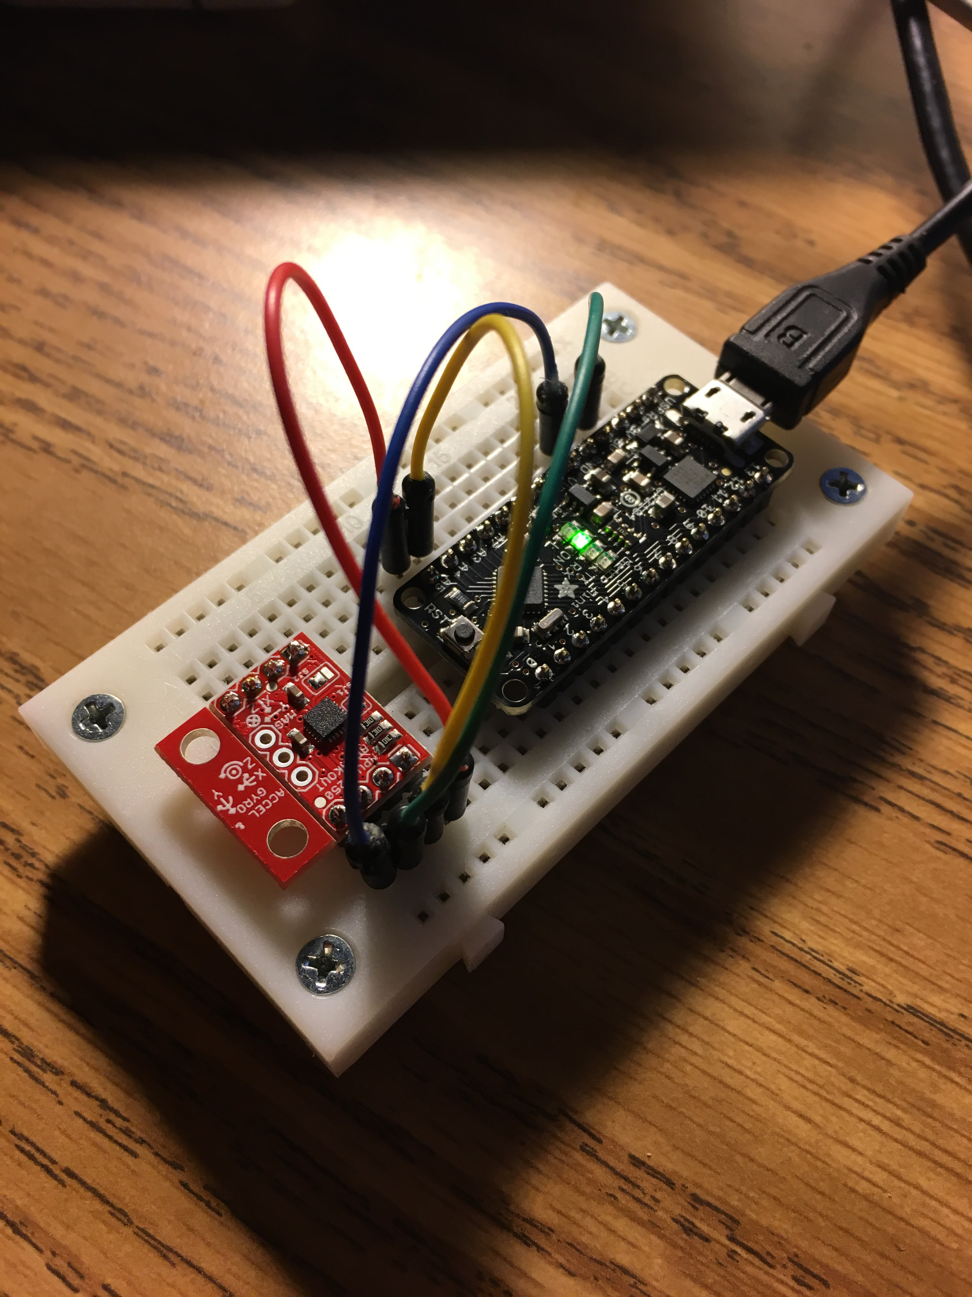
Roger’s Current Stage
Metro Mini 328
(Microcontroller)
MPU-9250
(IMU)
I2C Protocol Pins
Notes:
Currently, we have completed the hardware setup that using a Metro Mini microcontroller and MPU-9250 IMU, the microcontroller and IMU are hooked up by using I2C protocol

Slide 3
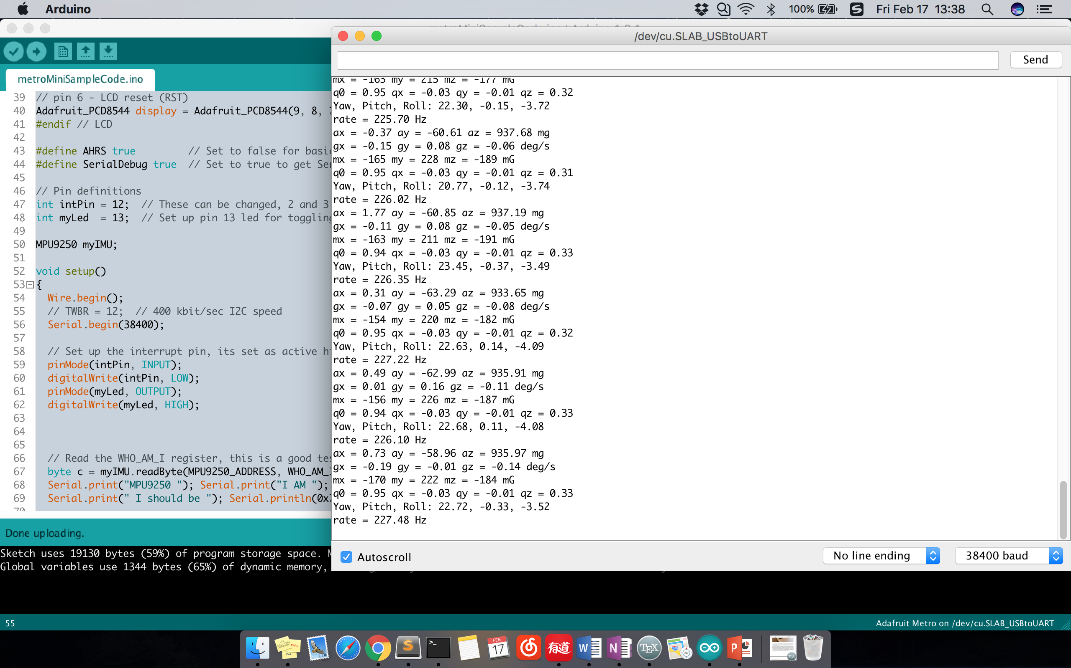
Notes:
and we can now use Arduino IDE for programming and uploading the program to the microcontroller. From the perspective of software, we are able to recognize the address of connected IMU and read the output data from all three sensors of the MPU-9250 including acceleration (accelerator value), gyroscope values and magnetometer value. In addition, we discovered filtering algorithms called Attitude Heading Reference System
That the algorithm allows to get quaternion output based on the raw data of the sensor, here is a screen shot of generating quaternion values by using sample code and existing libraries.

Slide 4
Roger’s Leftover
Add multiple IMUs onto a single microcontroller
Get precise error of all IMUs/ sensors
Develop an alignment algorithm for aligning a group of quaternion data.
Develop demonstration interface.
Notes:
We still need to figure out how to connect slave IMUs and select the correct address of expected IMU by using I2C protocol, by using multiple IMUs as one set allows to get a more precise data by taking the average values,
Correctly calibrate the sensor error before using the sensor data to the algorithm
~
Krisna is working on this part

Slide 5
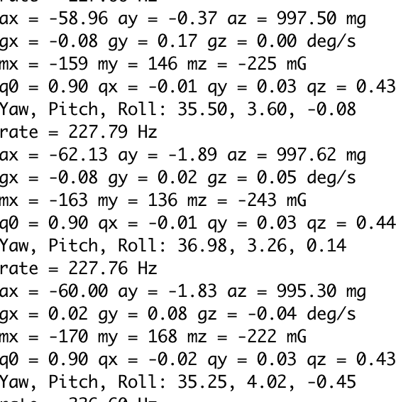
Roger’s Problems
Knowing the actual error of the IMU/sensors.
Notes:
It is difficult to measure actual precise error of the sensor data by just looking at it output data since the error could be very minor and unstable. Here is a screenshot comes from three groups of random data, the IMU is in a static motion and lying flat on a horizontal groud,
Error is obvious

Slide 6
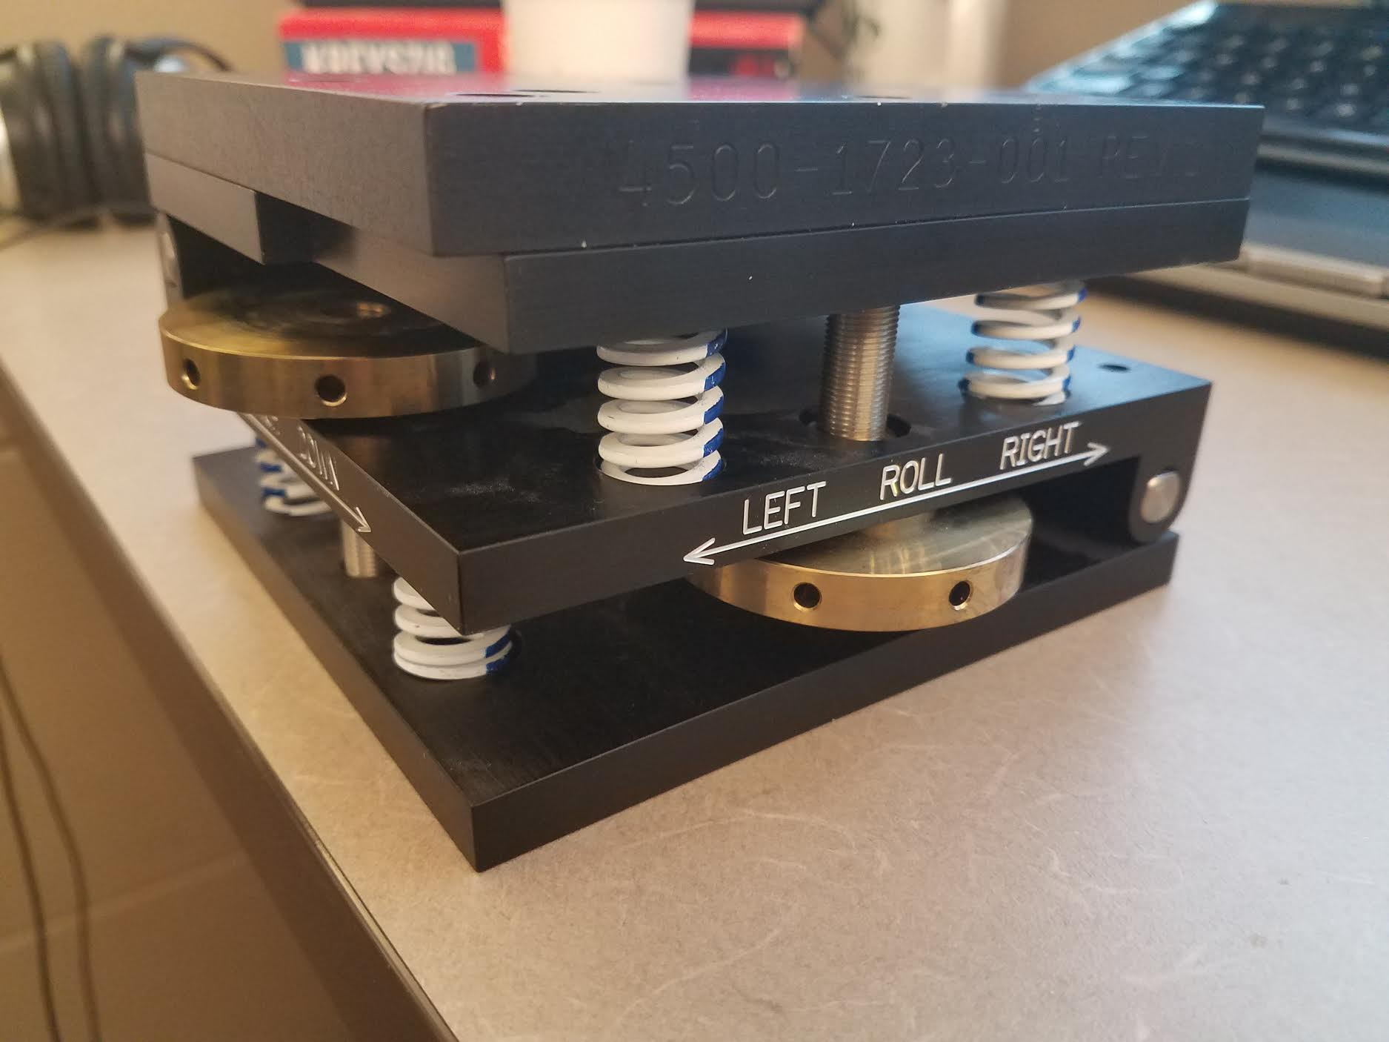
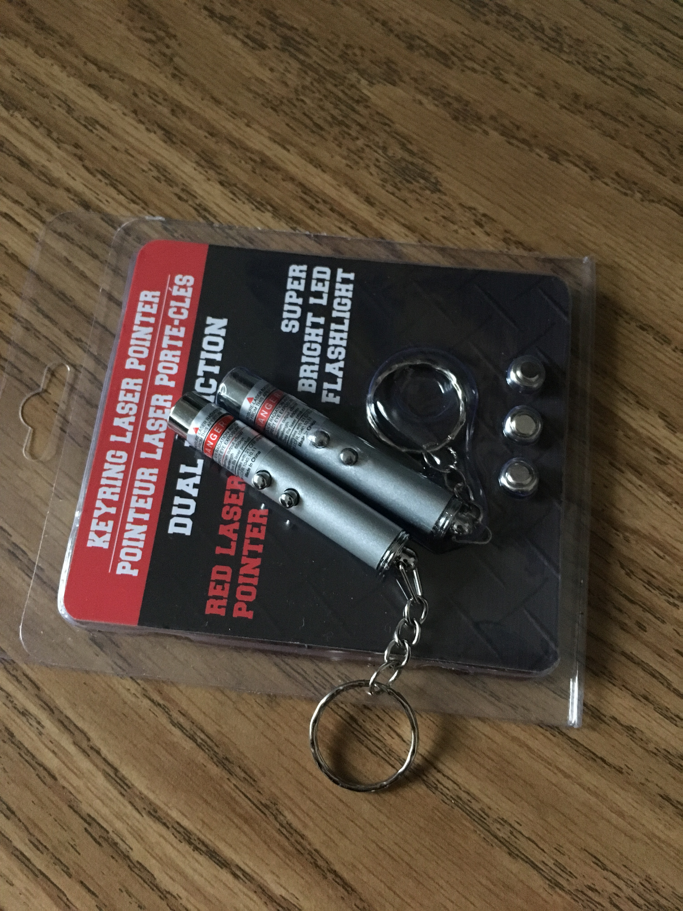
Solution
Knowing the actual error of the IMU/sensors.
Notes:
A solution that we came up for knowing the actual error of a IMU is to use a physics exeriment to measure the actual adjusted tilt/angle, by comparing the this tilt value with the sensor output data. An actual alter angle can be known by using a laser pointer and a mechanical angle adjuster for assistant tools, A mechanical angle adjuster allows to be manually set for getting a certain degree of tilt for simulating yaw, pitch and roll, that will be able to provide a stable motion for the IMU as well as error measurement. A laser pointer is also necessary…

Slide 7
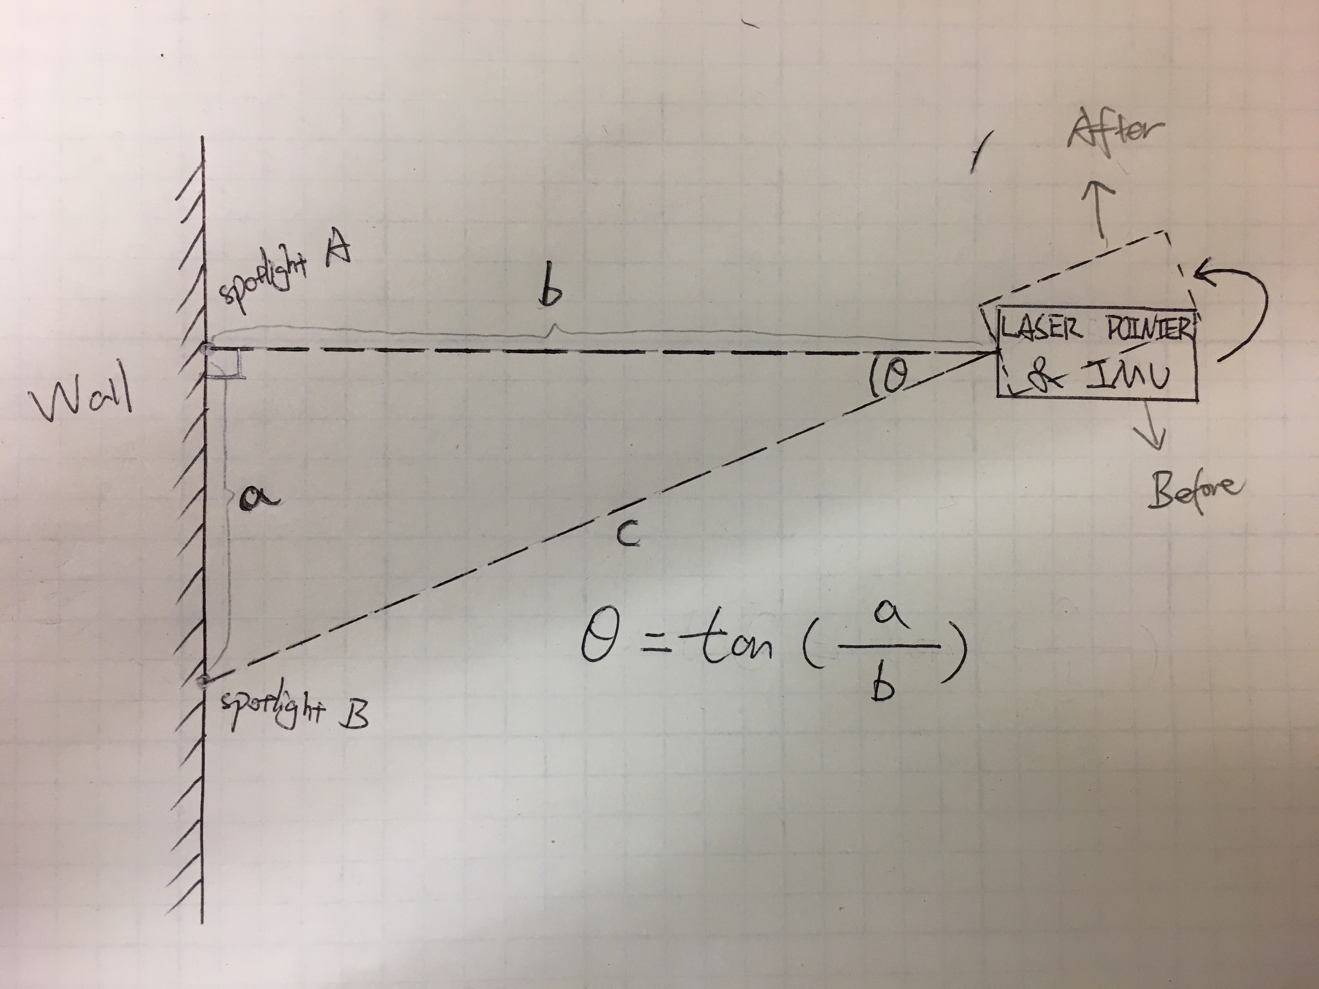
Sensor Error Measurement Experimental Design
Notes:
Here is a experimental diagram showing how we will measure the tilt and get the angle value from the measurement in a physics way
The block of solid line represents the laser pointer and IMU mounted together onto the MAA, and this is the initial motion, which this block of dashed line represents the same item but you can see it’s after making a tilt, here is the wall that is in a parallel position with the block.
As a result, a triangle will be constructed by imagine the edges of the initial distance between the laser pointer and the wall (b), alternative distance between the laser pointer and wall, as well as the distance between two spotlight (b), Theta represents the angle between adjusting the angle, and by measuring the distance value of “a” and “b”, theta can be calculated by applying trigonometric function. Assume theta is the actual precise angle (in radian), the error of the IMU sensor can be measured by comparing the actual precise angle with the output data from the IMU.

Slide 8
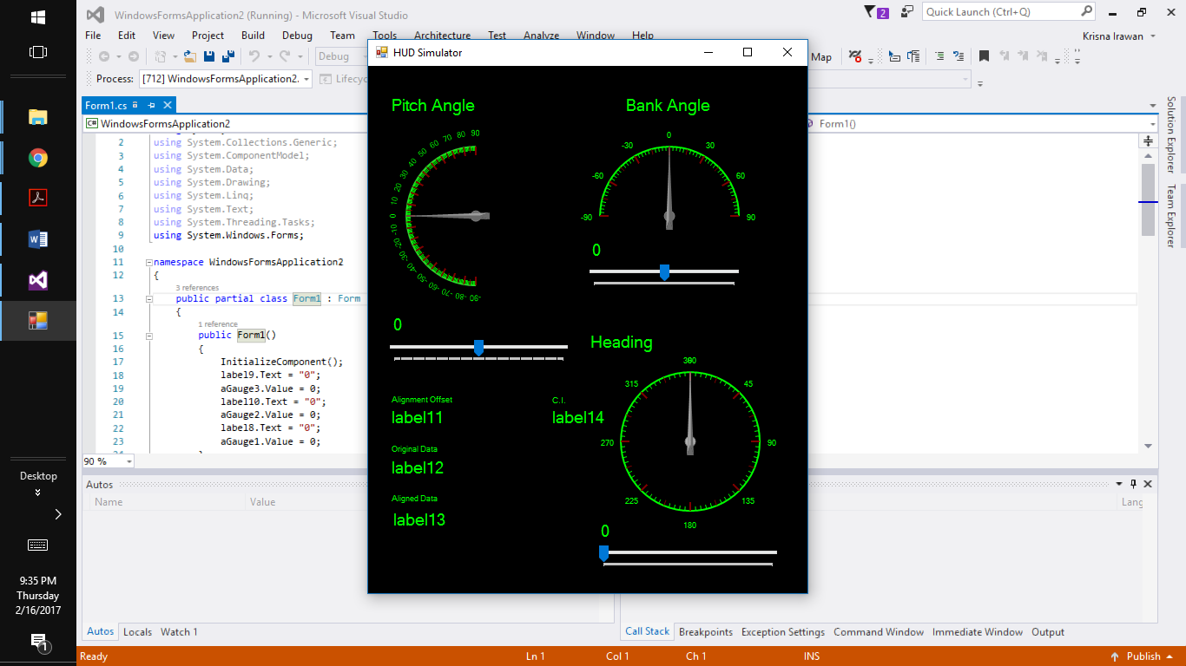
Krisna’s Current Stage
I am at the stage of connecting the graphical user interface that I created in Visual Studio to the offset algorithm part of the software created in Arduino by my teammates.
The graphical user interface run smoothly and ready to be connected.
Will need to do the first user study with the clients.

Slide 9
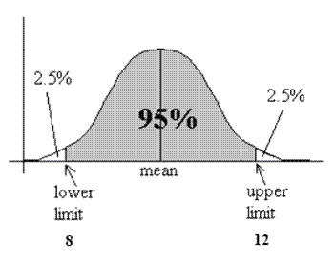
Krisna’s Leftover
Connect the GUI to the Arduino part of the software.
Need to run first user study with the clients.
Statistical Analaysis implementation of the software.
Source: https://i1.wp.com/cpmc.coriell.org/images/c_interval.gif

Slide 10
Hardware Logistic: Problem and Solution
Not be able to get the necessary hardware on timely manner.
Pro-actively contact the instructor and the TA to get the hardware.
Set up a meeting with the clients to let them know about the logistical problem that we were having.
Work in parallel to save time

Slide 11
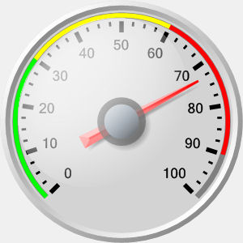
Generic HUD Symbology: Problem and Solution
Rockwell Collins uses a different methodology of generating the HUD display.
No imports file available to help generate the HUD symbology.
Use a gauge icon to represent the HUD symbology.
Source: https://www.targetdashboard.com/nlimages/badgauge.jpg

Slide 12
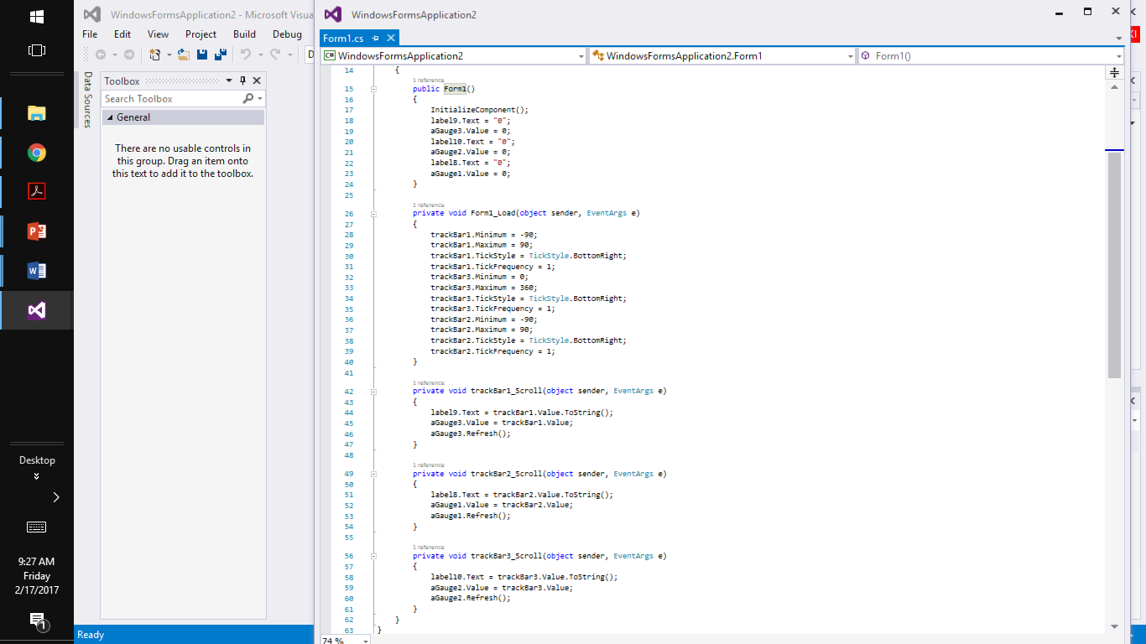
Sample Code

Slide 13
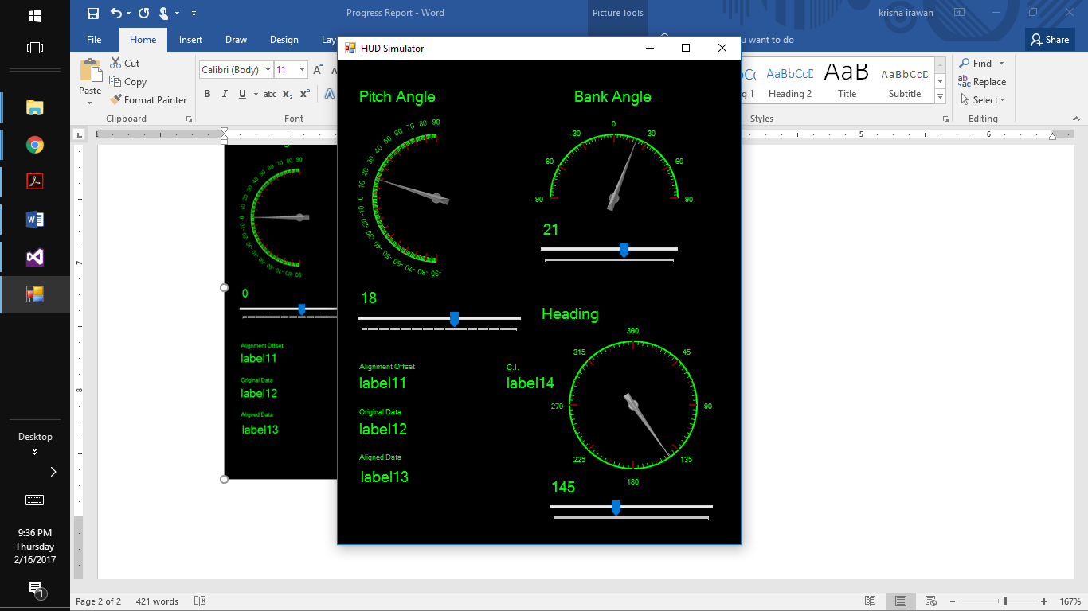
First User Study
Conduct the user study with my friends.
Need explanation to help the user understand the graphical user interface.
Need to conduct the user study with the clients.

Slide 14
Demonstration of Graphical User Interface

Slide 15
Drew’s Current Stage
Acquired hardware
Soldered and modified hardware to satisfy project requirements
Connected two IMUs to microcontroller via single I2C bus
Initialized/calibrated IMUs at startup to improve accuracy
Configured each IMU to act as master to their external sensors
Retrieved accelerometer, gyroscope and magnetometer data from each IMU

Slide 16
Drew’s Current Stage
Converted IMU sensor data to quaternions with the Sebastian Madgwick filter fusion algorithm
Found difference between the two IMUs

Slide 17
Acquired hardware
Adafruit Metro Mini 328 - 5V 16MHz
SparkFun IMU Breakout - MPU-9250
Three microcontrollers and three IMUs

Slide 18
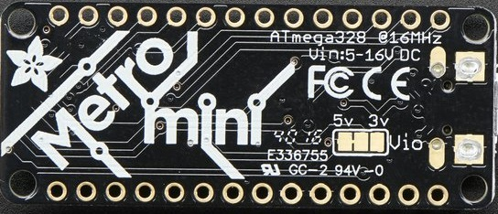
Soldered and modified hardware to satisfy project requirements
Soldered pins below both IMUs and microcontroller
Cut and soldered jumper on microcontroller

Slide 19
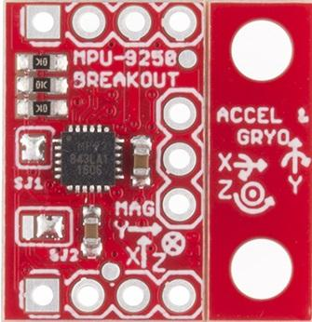
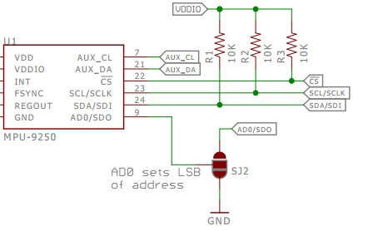
Soldered and modified hardware to satisfy project requirements
Resoldered jumper on IMUs

Slide 20
Connected two IMUs to microcontroller via single I2C bus
Rapid prototyping via breadboard

Slide 21
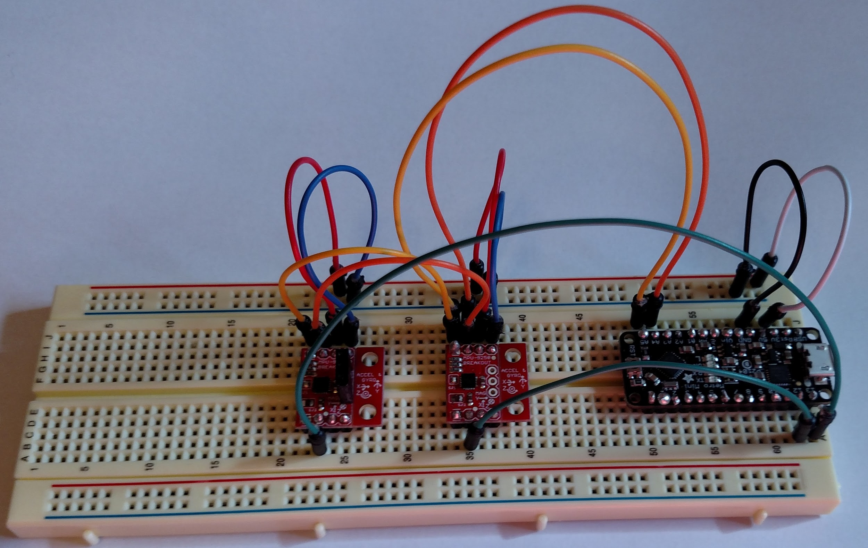

Slide 22
Initialized/calibrated IMUs at startup to improve accuracy
Sample at-rest readings from both gyro and accelerometer after device initialization.
Calculate average offsets
Store offsets in accelerometer and gyro bias registers

Slide 23
Configured each IMU to act as master to their external sensors
Configure the IMU to act as Master to external sensors
Setup addresses, registers and controls for each sensor
Differences between magnetometer and other sensors

Slide 24
Retrieved accelerometer, gyroscope and magnetometer data from each IMU
Used 3.3v digital logic pins on microcontroller to adjust IMU address
Followed I2C when accessing individual IMUs
Serial communication via arduino Wire library
Data retrieval following IMU specifications

Slide 25
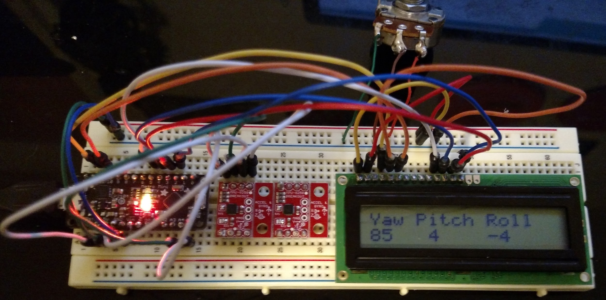

Slide 26
Converted IMU sensor data to quaternions with the Sebastian Madgwick filter fusion algorithm
Quaternion-based estimate of device orientation by fusing sensor data
Open source via xioTechnologies

Slide 27
Found difference between the two IMUs
Difference = q1 * Inverse(q2)

Slide 28
Thank you for listening!
Notes:
This is the end of …4

